Slide 1
Image Processing on
Deep corn

Slide 2
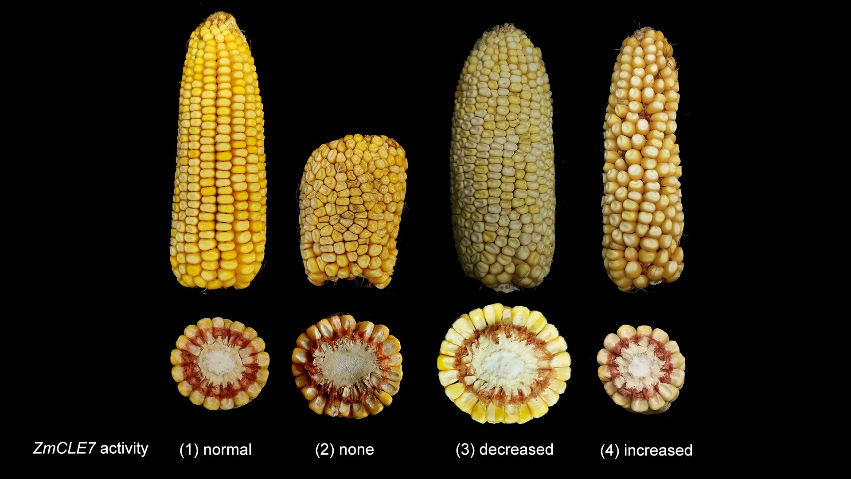
INTRODUCTION
The corn image processing was done on various parameters like the depth of the kernels and the size of the kernel, the diseases of the corn leaves etc.
Basically we go through with manually to check the corn which is infected or not as well as counting of the kernels for each corn cob.

Slide 3
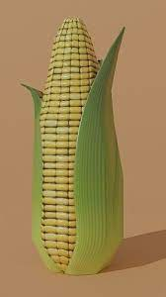
What is our Aim
Kernel Quality and
No. of Kernels per each
corn
Our Aim is calculate the length, width and kernels for each corn which is not plucked from the plant. By using the IoT devices or mobile lens.
Length of the corn

Slide 4
2D Vs 3D Image
2D Image
3D Image
In previous research there were went through taking counting of the kernel in 180 degrees and remaining 180 degrees will be calculated by a value of 2.7
The counting is difficult and to identify disease of the plant is also most important.
In 3D, we will take the help of IoT devices and take the snap of 360 degree of the corn which is not plucked from the tree.
By testing the silk hair, leafs of the corn plant all are done by IoT device lens.
Length, width of the corn are measured.

Slide 5
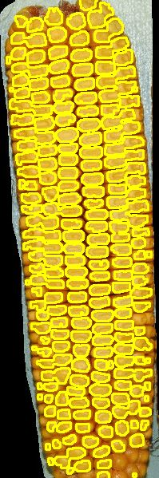
Process of Calculating the kernels
Corn kernel Countor’s
With only 2D-Image
First, we are identifying the color code of the corn and also the desired color of the corn is light medium shade of yellow.
By assuming the yellow color palette has lower and upper yellow.
So, we are moving forward to calculate the kernels from the corn by counter's mapping.

Slide 6

Corn Kernels Counting and Display the Yellow and Red colour Kernels
Corn Kernel Colour
→ Corn kernel colours are identifying by the colour detection using the some of the parameters which are yellow, red and orange colour.
→ Due to lighting conditions, we need the colour of the kernel will varies. So we need to go through to these parameters.
→ The Colour output has show beside in the figure...

Slide 7

Output of the Corn Kernels
Description | Result | Remarks
Corn Ear Length | 19.82 Cm
Corn Ear Width | 5.51 Cm
No. of Kernels | 160 X 2.7 = 457 | Some are damaged

Slide 8
Summary
The corn colour, kernels and length width are calculated by using Python and some of the image processing technique's.
As we seen the number of kernels is 163 and it is taken only in the 2D image and calculated by the desired value of 2.7 which is still existing in the Chinese research.
So, We are still working on it to take the 360 degree image of the corn and get the exact kernels for one corn.

Slide 9
Any Queries

